Slide 1
Machine Learning
“A field of study that gives computers the capability to learn without being explicitly programmed."

Slide 2

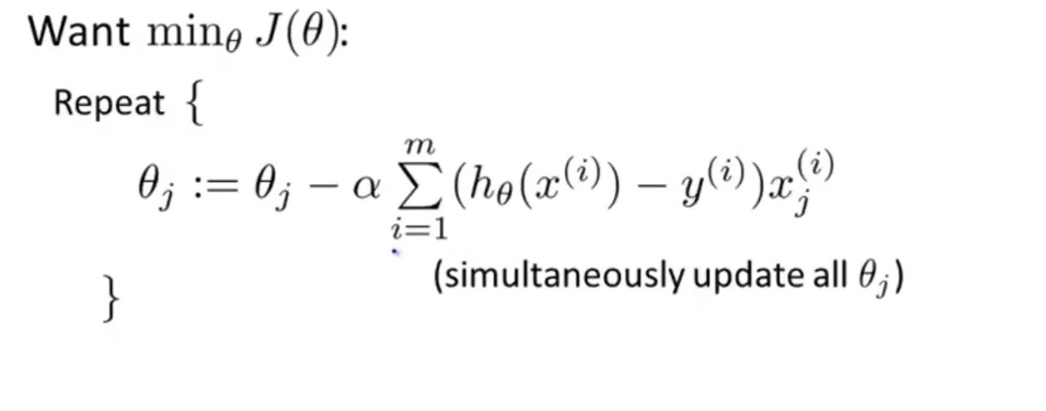
Gradient Descent
Now the question arises, how do we reduce the cost value. Well, this can be done by using Gradient Descent. The main goal of Gradient descent is to minimize the cost value. i.e. min J(θ).
Now to minimize our cost function we need to run the gradient descent function on each parameter i.e.

Slide 3
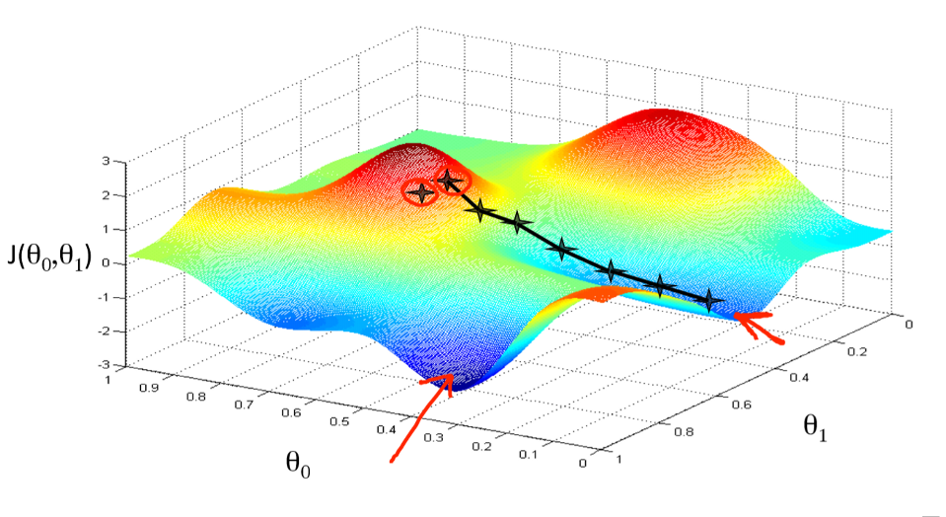
Gradient descent has an analogy in which we have to imagine ourselves at the top of a mountain valley and left stranded and blindfolded, our objective is to reach the bottom of the hill. Feeling the slope of the terrain around you is what everyone would do. Well, this action is analogous to calculating the gradient descent, and taking a step is analogous to one iteration of the update to the parameters.

Slide 4
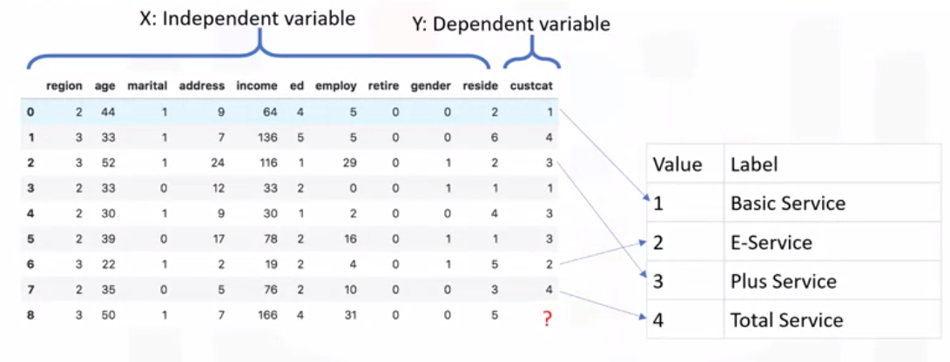
K-Nearest Neighbors

Slide 5
K-Nearest Neighbors cont’d
This algorithm classifies cases based on their similarity to other cases.
In K-Nearest Neighbors, data points that are near each other are said to be neighbors.
K-Nearest Neighbors is based on this paradigm:
Similar cases with the same class labels are near each other. Thus, the distance between two cases is a measure of their dissimilarity. There are different ways to calculate the similarity or conversely, the distance or dissimilarity of two data points.
For example, this can be done using Euclidean distance.

Slide 6
K-Nearest Neighbors cont’d
The K-Nearest Neighbors algorithm works as follows:
Pick a value for K.
Calculate the distance from the new case hold out from each of the cases in the dataset.
Search for the K-observations in the training data that are nearest to the measurements of the unknown data point.
Predict the response of the unknown data point using the most popular response value from the K-Nearest Neighbors.

Slide 7
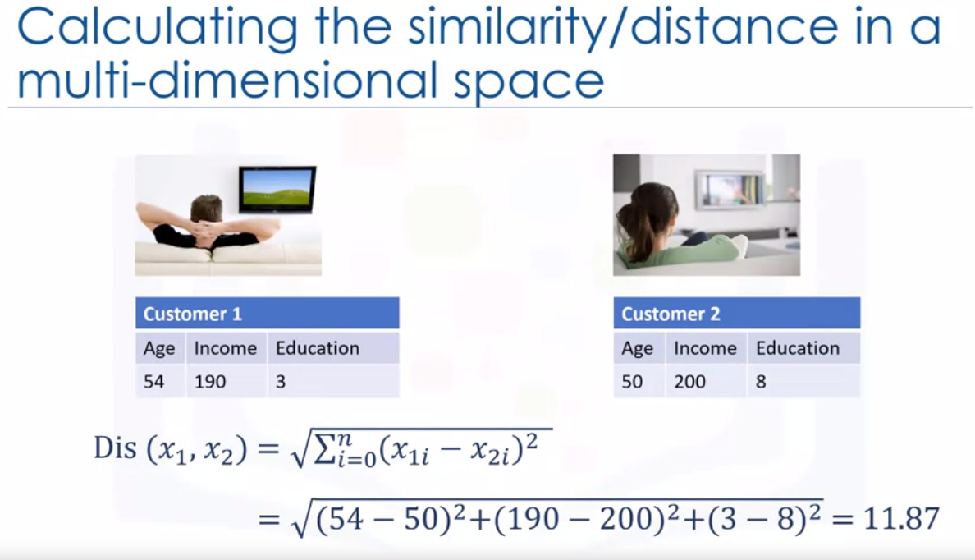

Slide 8
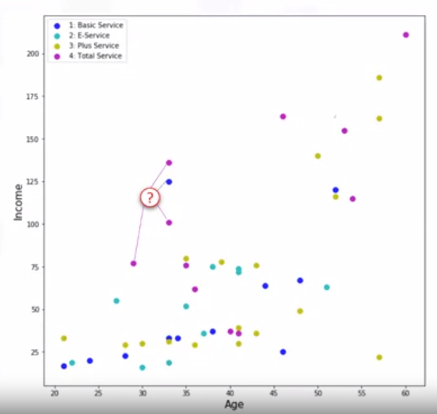
How to select the correct K
As mentioned, K and K-Nearest Neighbors is the number of nearest neighbors to examine.
It is supposed to be specified by the user. So, how do we choose the right K?
Assume that we want to find the class of the customer noted as question mark on the chart.
What happens if we choose a very low value of K?
Let's say, K equals one. The first nearest point would be blue, which is class one. This would be a bad prediction, since more of the points around it are magenta or class four.

Slide 9
In fact, since its nearest neighbor is blue we can say that we capture the noise in the data or we chose one of the points that was an anomaly in the data. A low value of K causes a highly complex model as well, which might result in overfitting of the model.
It means the prediction process is not generalized enough to be used for out-of-sample cases. Out-of-sample data is data that is outside of the data set used to train the model.
In other words, it cannot be trusted to be used for prediction of unknown samples. It's important to remember that overfitting is bad, as we want a general model that works for any data, not just the data used for training.
Now, on the opposite side of the spectrum, if we choose a very high value of K such as K equals 20, then the model becomes overly generalized.

Slide 10
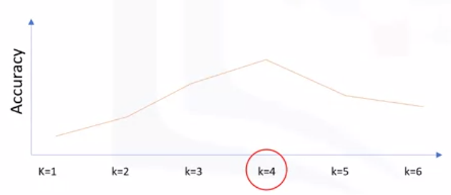
So, how can we find the best value for K?
The general solution is to reserve a part of your data for testing the accuracy of the model. Once you've done so, choose K equals one and then use the training part for modeling and calculate the accuracy of prediction using all samples in your test set.
Repeat this process increasing the K and see which K is best for your model. For example, in our case, K equals four will give us the best accuracy.

Slide 11
Advantages of KNN
No Training Period: KNN is called Lazy Learner (Instance based learning). It does not learn anything in the training period. It does not derive any discriminative function from the training data. In other words, there is no training period for it. It stores the training dataset and learns from it only at the time of making real time predictions. This makes the KNN algorithm much faster than other algorithms that require training e.g. SVM, Linear Regression etc.
Since the KNN algorithm requires no training before making predictions, new data can be added seamlessly which will not impact the accuracy of the algorithm.
KNN is very easy to implement. There are only two parameters required to implement KNN i.e. the value of K and the distance function (e.g. Euclidean or Manhattan etc.)

Slide 12
Disadvantages of KNN
Does not work well with large dataset: In large datasets, the cost of calculating the distance between the new point and each existing points is huge which degrades the performance of the algorithm.
Does not work well with high dimensions: The KNN algorithm doesn't work well with high dimensional data because with large number of dimensions, it becomes difficult for the algorithm to calculate the distance in each dimension.
Sensitive to noisy data, missing values and outliers: KNN is sensitive to noise in the dataset. We need to manually impute missing values and remove outliers.

Slide 13
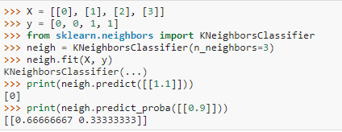

Slide 14
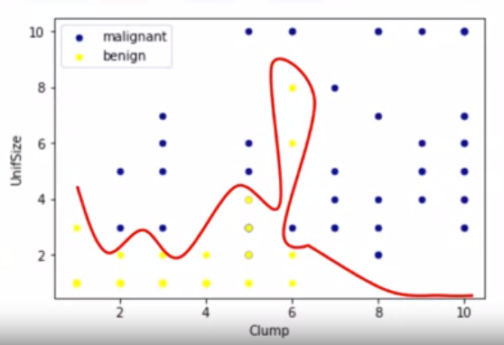
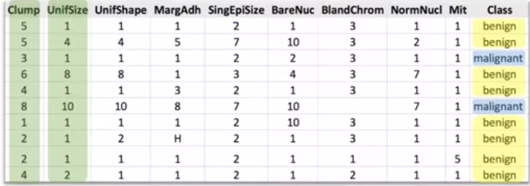
SUPPORT VECTOR MACHINE(SVM)
A Support Vector Machine is a supervised algorithm that can classify cases by finding a separator.
SVM works by first mapping data to a high dimensional feature space so that data points can be categorized, even when the data are not linearly separable.
Then, a separator is estimated for the data. The data should be transformed in such a way that a separator could be drawn as a hyperplane.

Slide 15
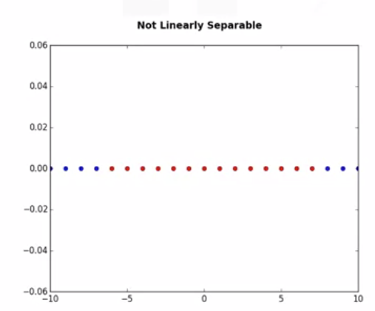
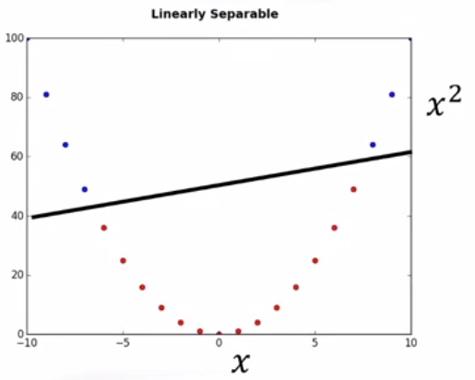

DATA TRANFORMATION
For the sake of simplicity, imagine that our dataset is one-dimensional data. This means we have only one feature x. As you can see, it is not linearly separable. Well, we can transfer it into a two-dimensional space. For example, you can increase the dimension of data by mapping x into a new space using a function with outputs x and x squared.
Basically, mapping data into a higher-dimensional space is called, kernelling. The mathematical function used for the transformation is known as the kernel function, and can be of different types; such as linear, polynomial, Radial Basis Function, or RBF, and sigmoid.

Slide 16
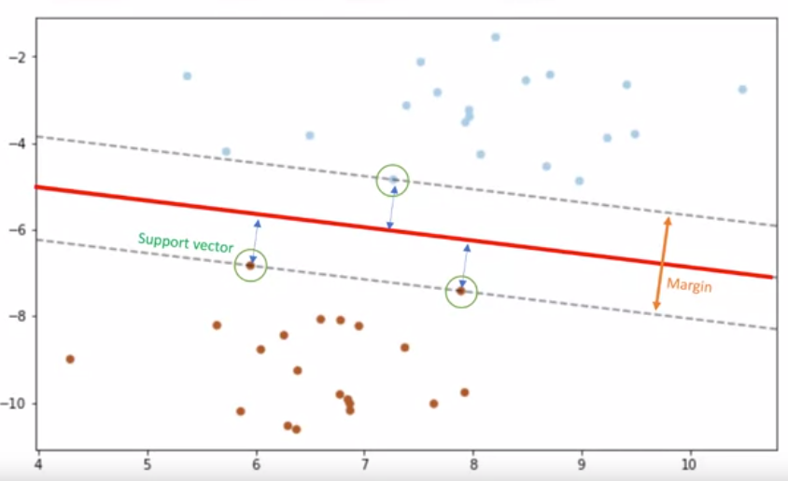
SVMs are based on the idea of finding a hyperplane that best divides a data set into two classes as shown here. As we're in a two-dimensional space, you can think of the hyperplane as a line that linearly separates the blue points from the red points.
ADVANTAGES
Accurate in high dimension place
Memory efficient
DISADVANTAGES
Small datasets
Prone to overfitting
APPLICATIONS
Image Recognition
Spam detection

Slide 17
Let’s code it!

